Slide 1
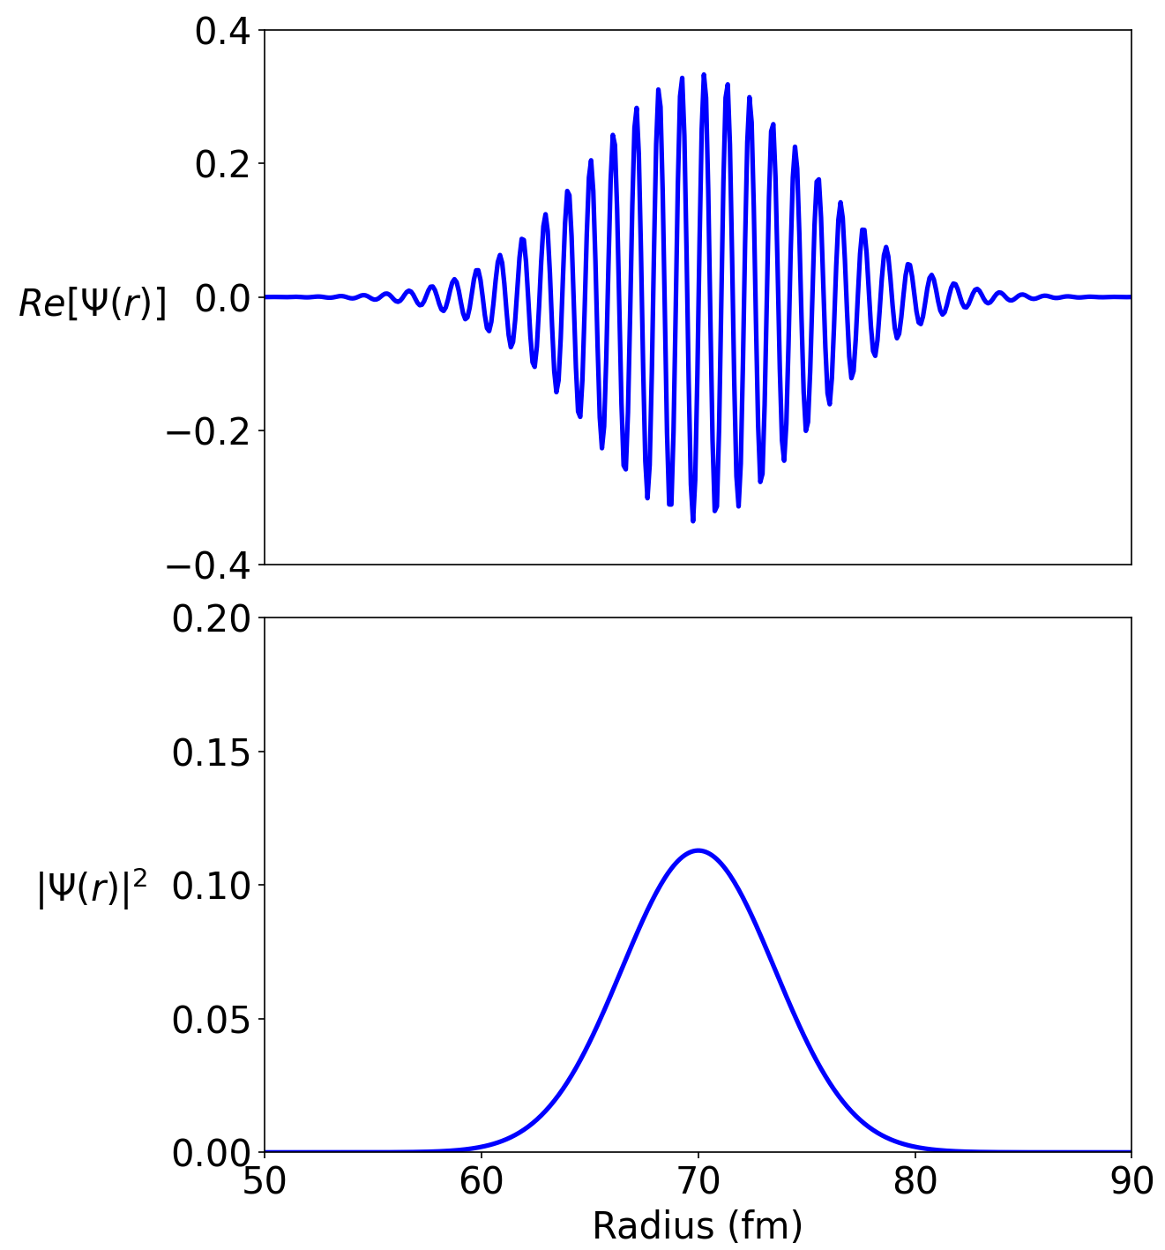
Simulating nuclear fusion
Lars Henden

Slide 2
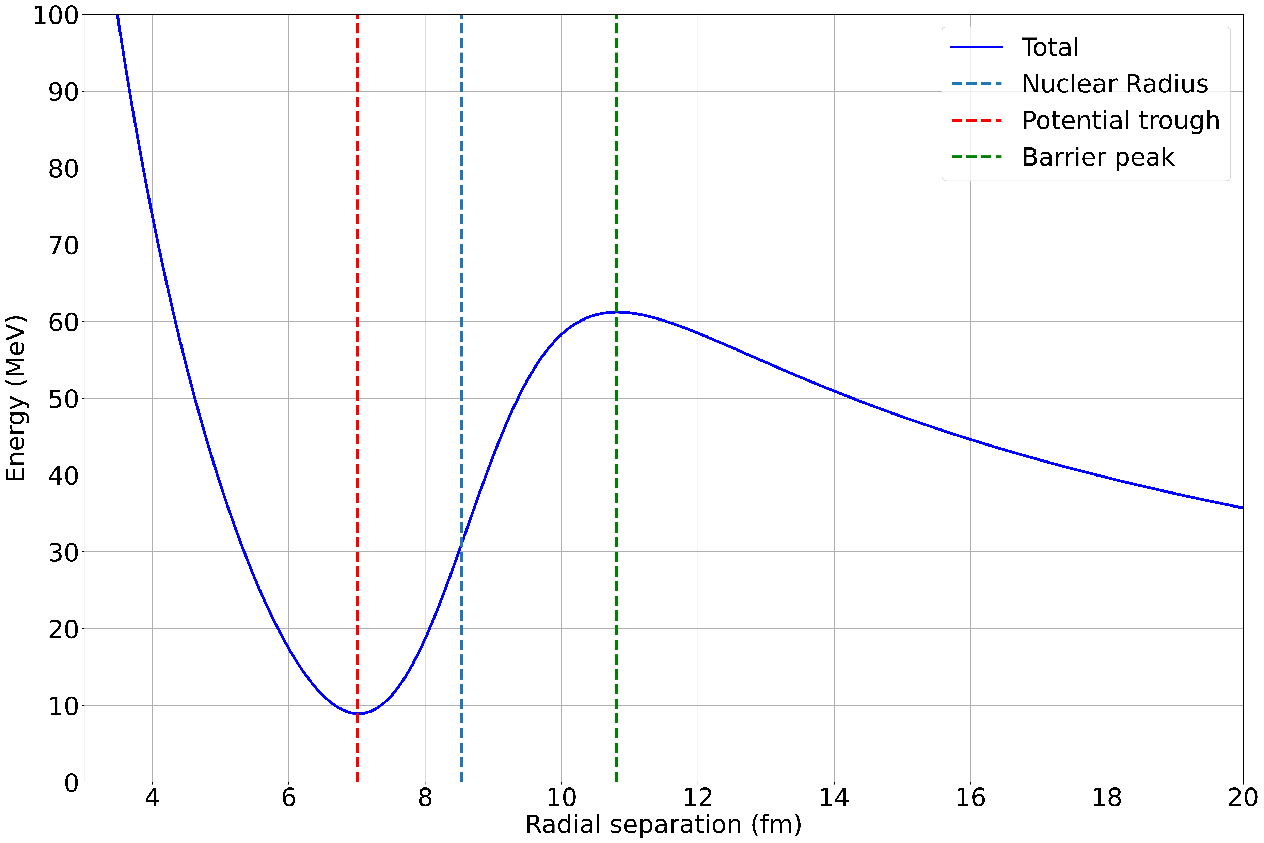
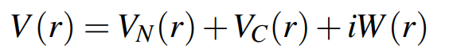
Single Barrier Model
Single body + Centre of Mass frame
¹⁶O + ¹⁴⁴Sm
Total system potential:
Real Coulomb term
Real Woods-Saxon term
Imaginary Absorption term
Simple fusion criteria
Quantum tunneling through barrier

Slide 3
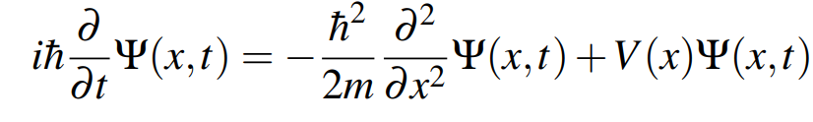
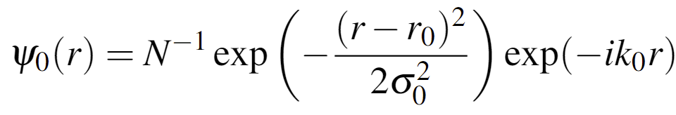
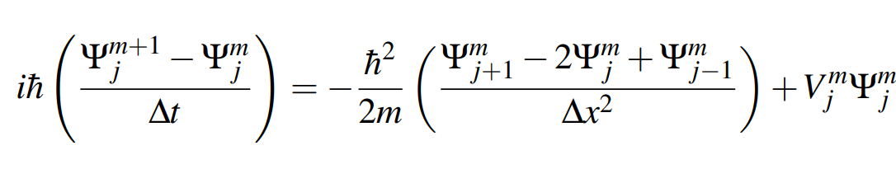
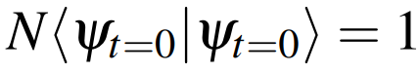
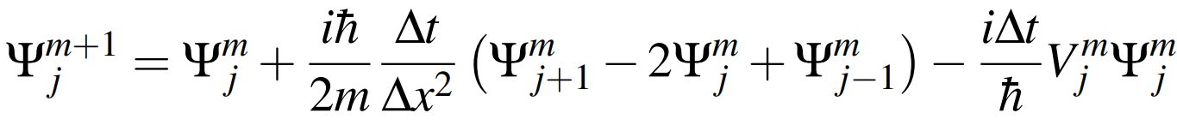

Simulation
Time Dependent Schrödinger equation:
Finite Difference Method TDSE:
Discretised spatial + temporal grids
Initial Wavefunction:
Gaussian Wave-Packet (GWP)
Initial boost of k₀
Must be normalized
Zero at boundaries
Probability of Fusion
Loss of Normalization

Slide 4
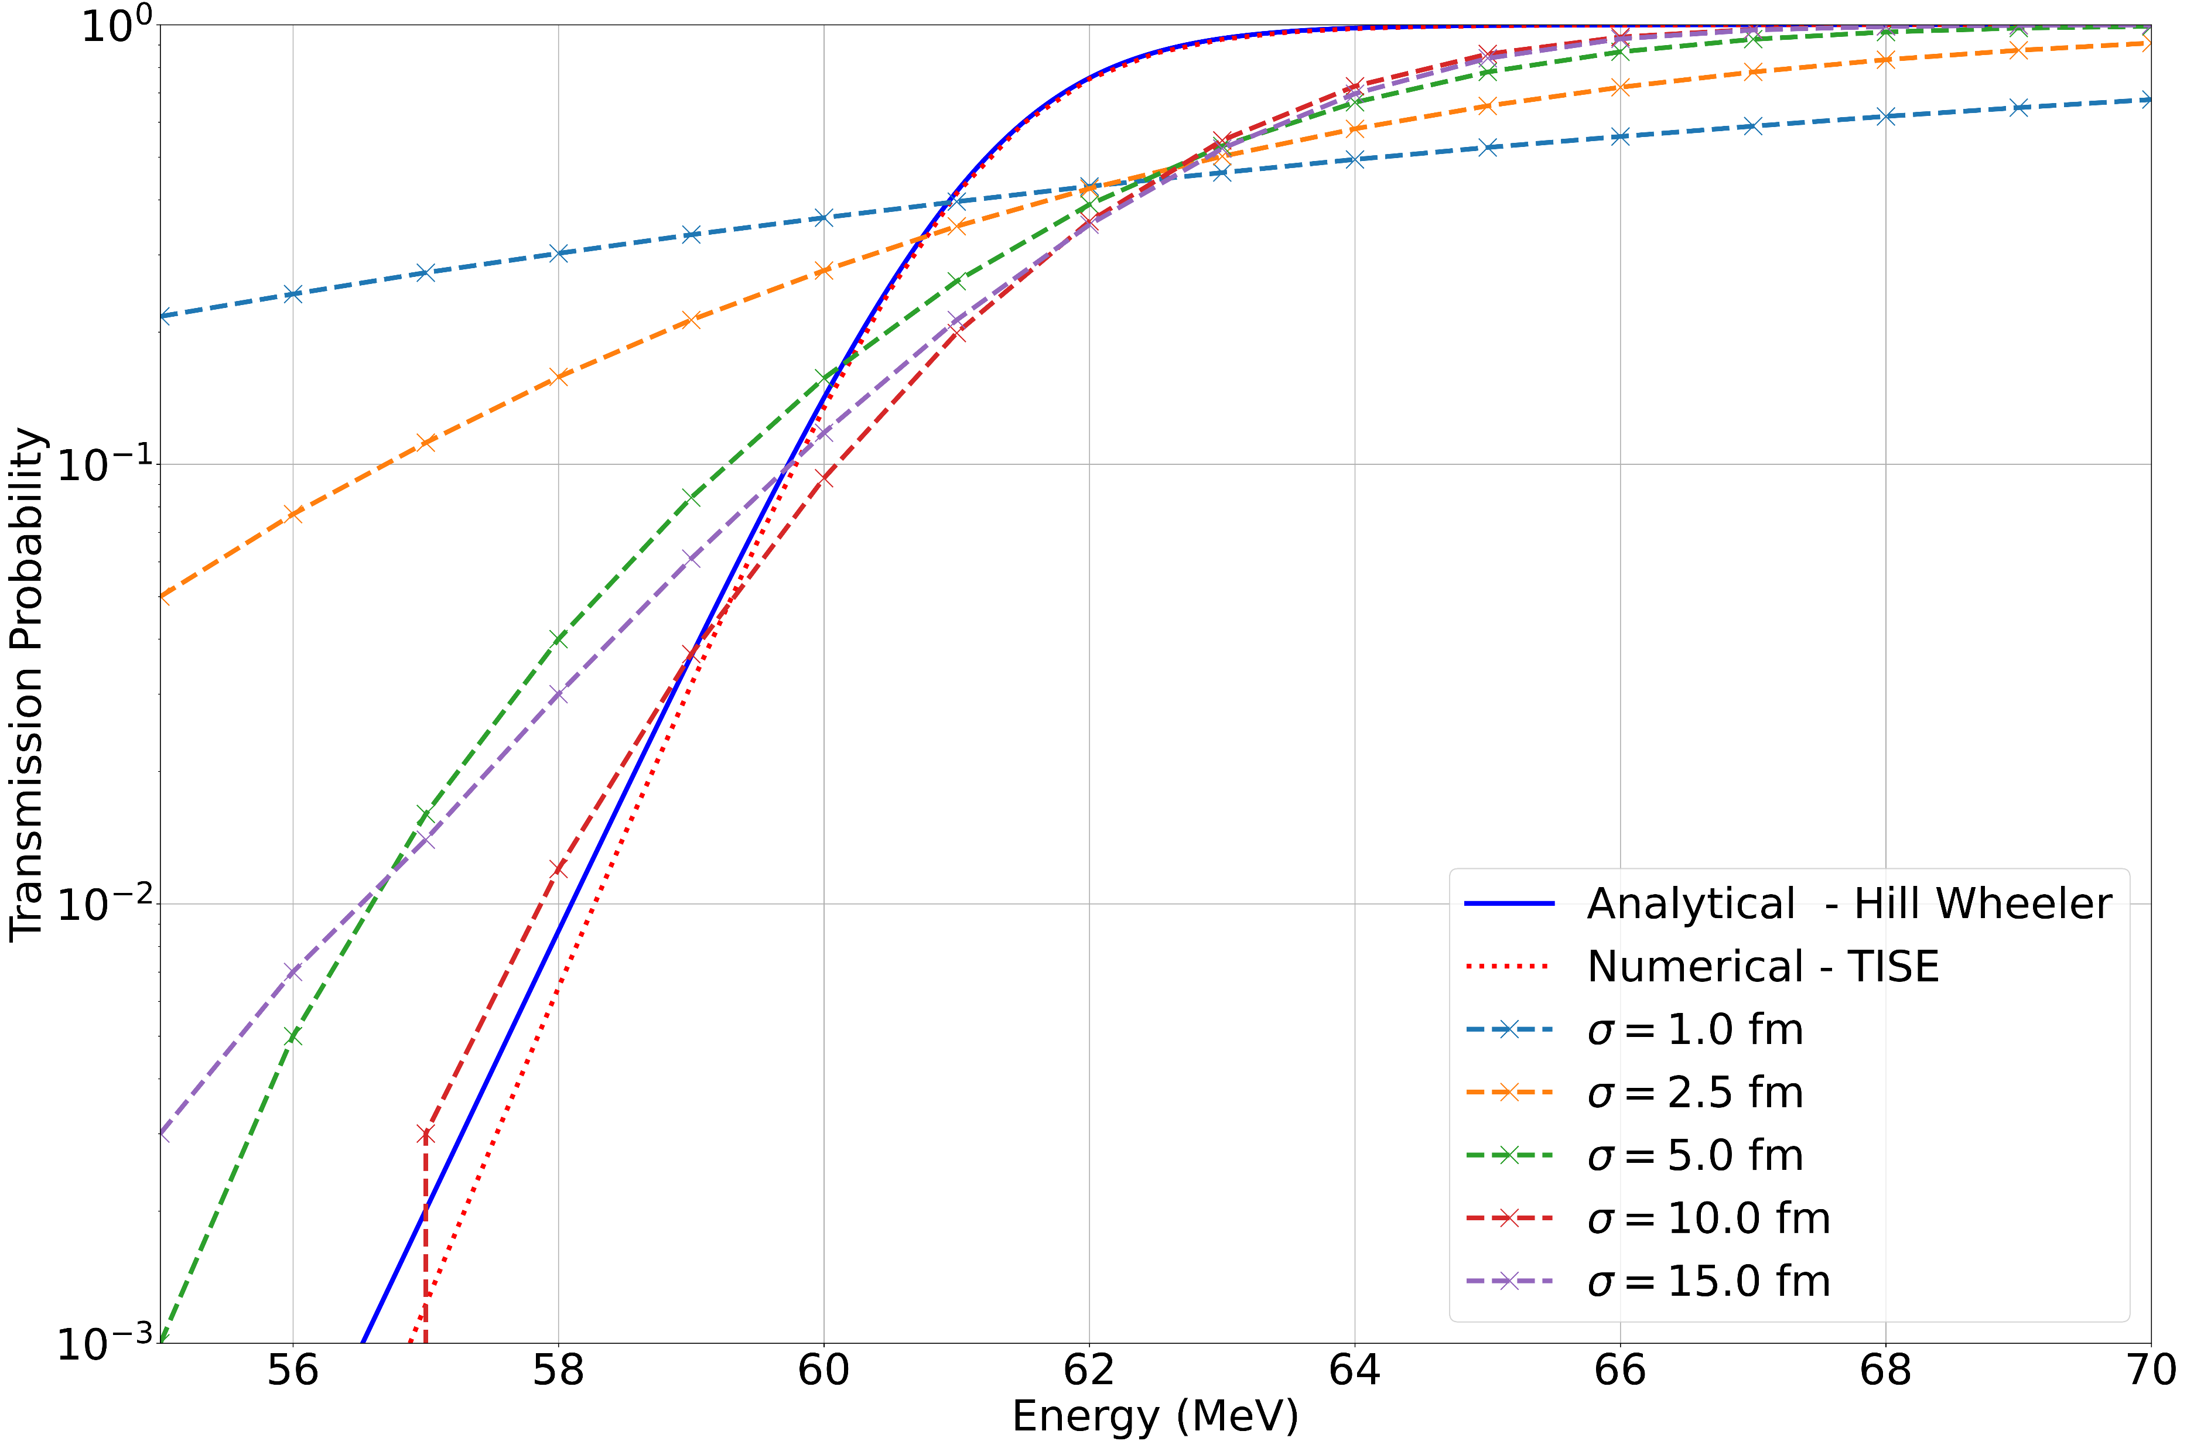
Results
Simulation Study:
Initial Gaussian Spatial Width:
σ₀ = 1, 2.5 , 5, 10, 15 fm
Simulated fusion over range of initial wave-packet energies:
55 ≤ E₀ ≤ 70 MeV
Key Result:
As σ₀ increases, TDSE solution tends to Analytical, and Numerical TISE solutions
Discussion:
GWP energy distribution
GWP dispersion
Viability of numerical method
Parameter fitting

Slide 5
References
[1] R. D. E. Atkinson and F. G. Houtermans. “Zur Frage der Aufbaumöglichkeit der Elemente in Sternen”. In: Zeitschrift fur Physik 54.9-10 (Sept. 1929), pp. 656–665. DOI: 10.1007/BF01341595.
[2] The Atomic Archive. "Mike" Device is Tested. Online. Date Accessed: 7 April 2024. URL: https ://www.atomicarchive.com/history/hydrogen-bomb/page-13.html.9
[3] ITER. WHAT IS ITER? Online. Date Accessed: 7 April 2024. URL: https://www.iter.org/proj/inafewlines.
[4] A. B. Balantekin and N. Takigawa. “Quantum tunneling in nuclear fusion”. In: Rev. Mod. Phys. 70 (1 1998), pp. 77–100. DOI: 10.1103/RevModPhys.70.77. URL: https://link.aps.org/doi/10.1103/RevModPhys.70.77.
[5] M. Dasgupta et al. “MEASURING BARRIERS TO FUSION”. In: Annual Review of Nuclear and ParticleScience 48.Volume 48, 1998 (1998), pp. 401–461. ISSN: 1545-4134. DOI: https://doi.org/10.1146/annurev.nucl.48.1.401. URL: https://www.annualreviews.org/content/journals/10.1146/annurev.nucl.48.1.401.
[6] Terence Vockerodt and Alexis Diaz-Torres. “Describing heavy-ion fusion with quantum coupled-channelswave-packet dynamics”. In: Phys. Rev. C 100 (3 2019), p. 034606. DOI: 10.1103/PhysRevC.100.034606. URL: https://link.aps.org/doi/10.1103/PhysRevC.100.034606.
[7] David Lawrence Hill and John Archibald Wheeler. “Nuclear Constitution and the Interpretation of FissionPhenomena”. In: Phys. Rev. 89 (5 1953), pp. 1102–1145. DOI: 10.1103/PhysRev.89.1102. URL:https://link.aps.org/doi/10.1103/PhysRev.89.1102.
[8] C. Y. Wong. “Interaction Barrier in Charged-Particle Nuclear Reactions”. In: Phys. Rev. Lett. 31 (12 1973),pp. 766–769. DOI: 10.1103/PhysRevLett.31.766. URL: https://link.aps.org/doi/10.1103/PhysRevLett.31.766.
[9] J. R. Leigh et al. “Barrier distributions from the fusion of oxygen ions with 144,148,154Sm and 186W”.In: Phys. Rev. C 52 (6 1995), pp. 3151–3166. DOI: 10 . 1103 / PhysRevC . 52 . 3151. URL: https ://link.aps.org/doi/10.1103/PhysRevC.52.3151.
[10] A.C Berriman et al. Barriers to Fusion. Online. Date Accessed: 8/4/2024. URL: https://inis.iaea.org/collection/NCLCollectionStore/_Public/31/033/31033889.pdf.
[11] E Piasecki, L. Swiderski, and J Jastrzebski. Fusion Barrier distributions. Online. Date Accessed: 8/4/2024.2007. URL: https://inis.iaea.org/collection/NCLCollectionStore/_Public/38/068/38068150.pdf.
[12] N. Rowley, G.R. Satchler, and P.H. Stelson. “On the “distribution of barriers” interpretation of heavy-ionfusion”. In: Physics Letters B 254.1 (1991), pp. 25–29. ISSN: 0370-2693. DOI: https://doi.org/10.1016/0370-2693(91)90389-8. URL: https://www.sciencedirect.com/science/article/pii/0370269391903898.

Slide 7
Additional Slides

Slide 8
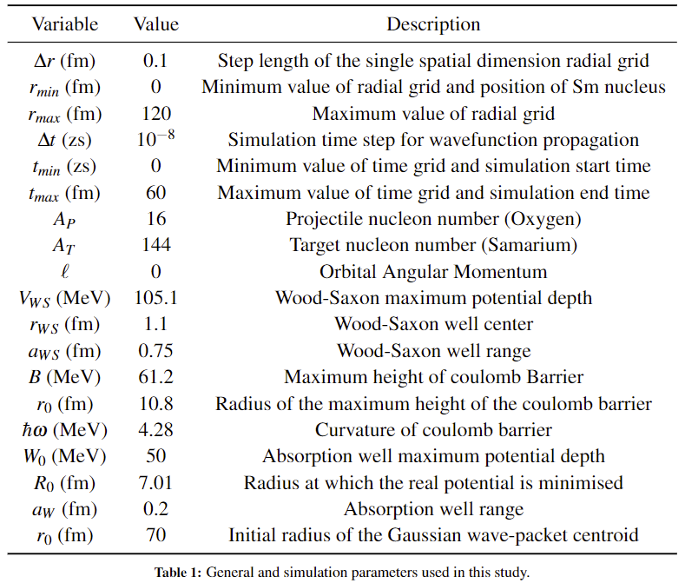
Simulation Parameters

Slide 9
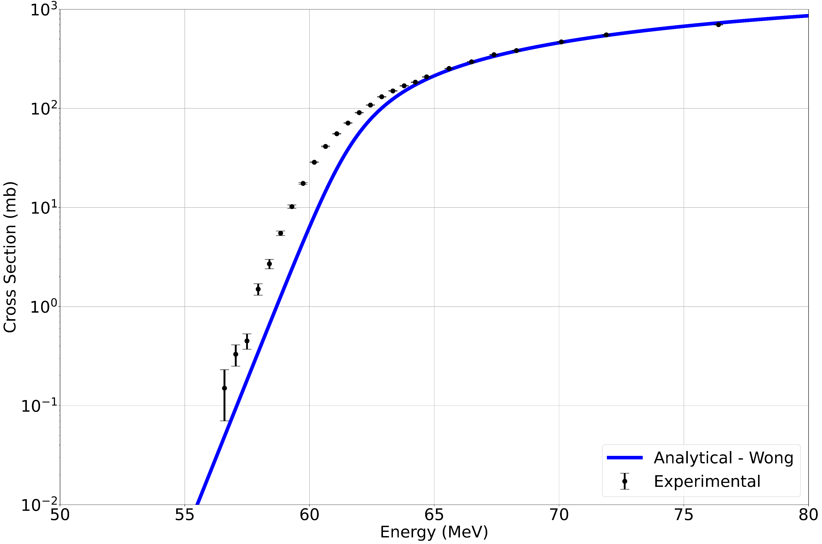
Nuclear Cross section

Slide 10
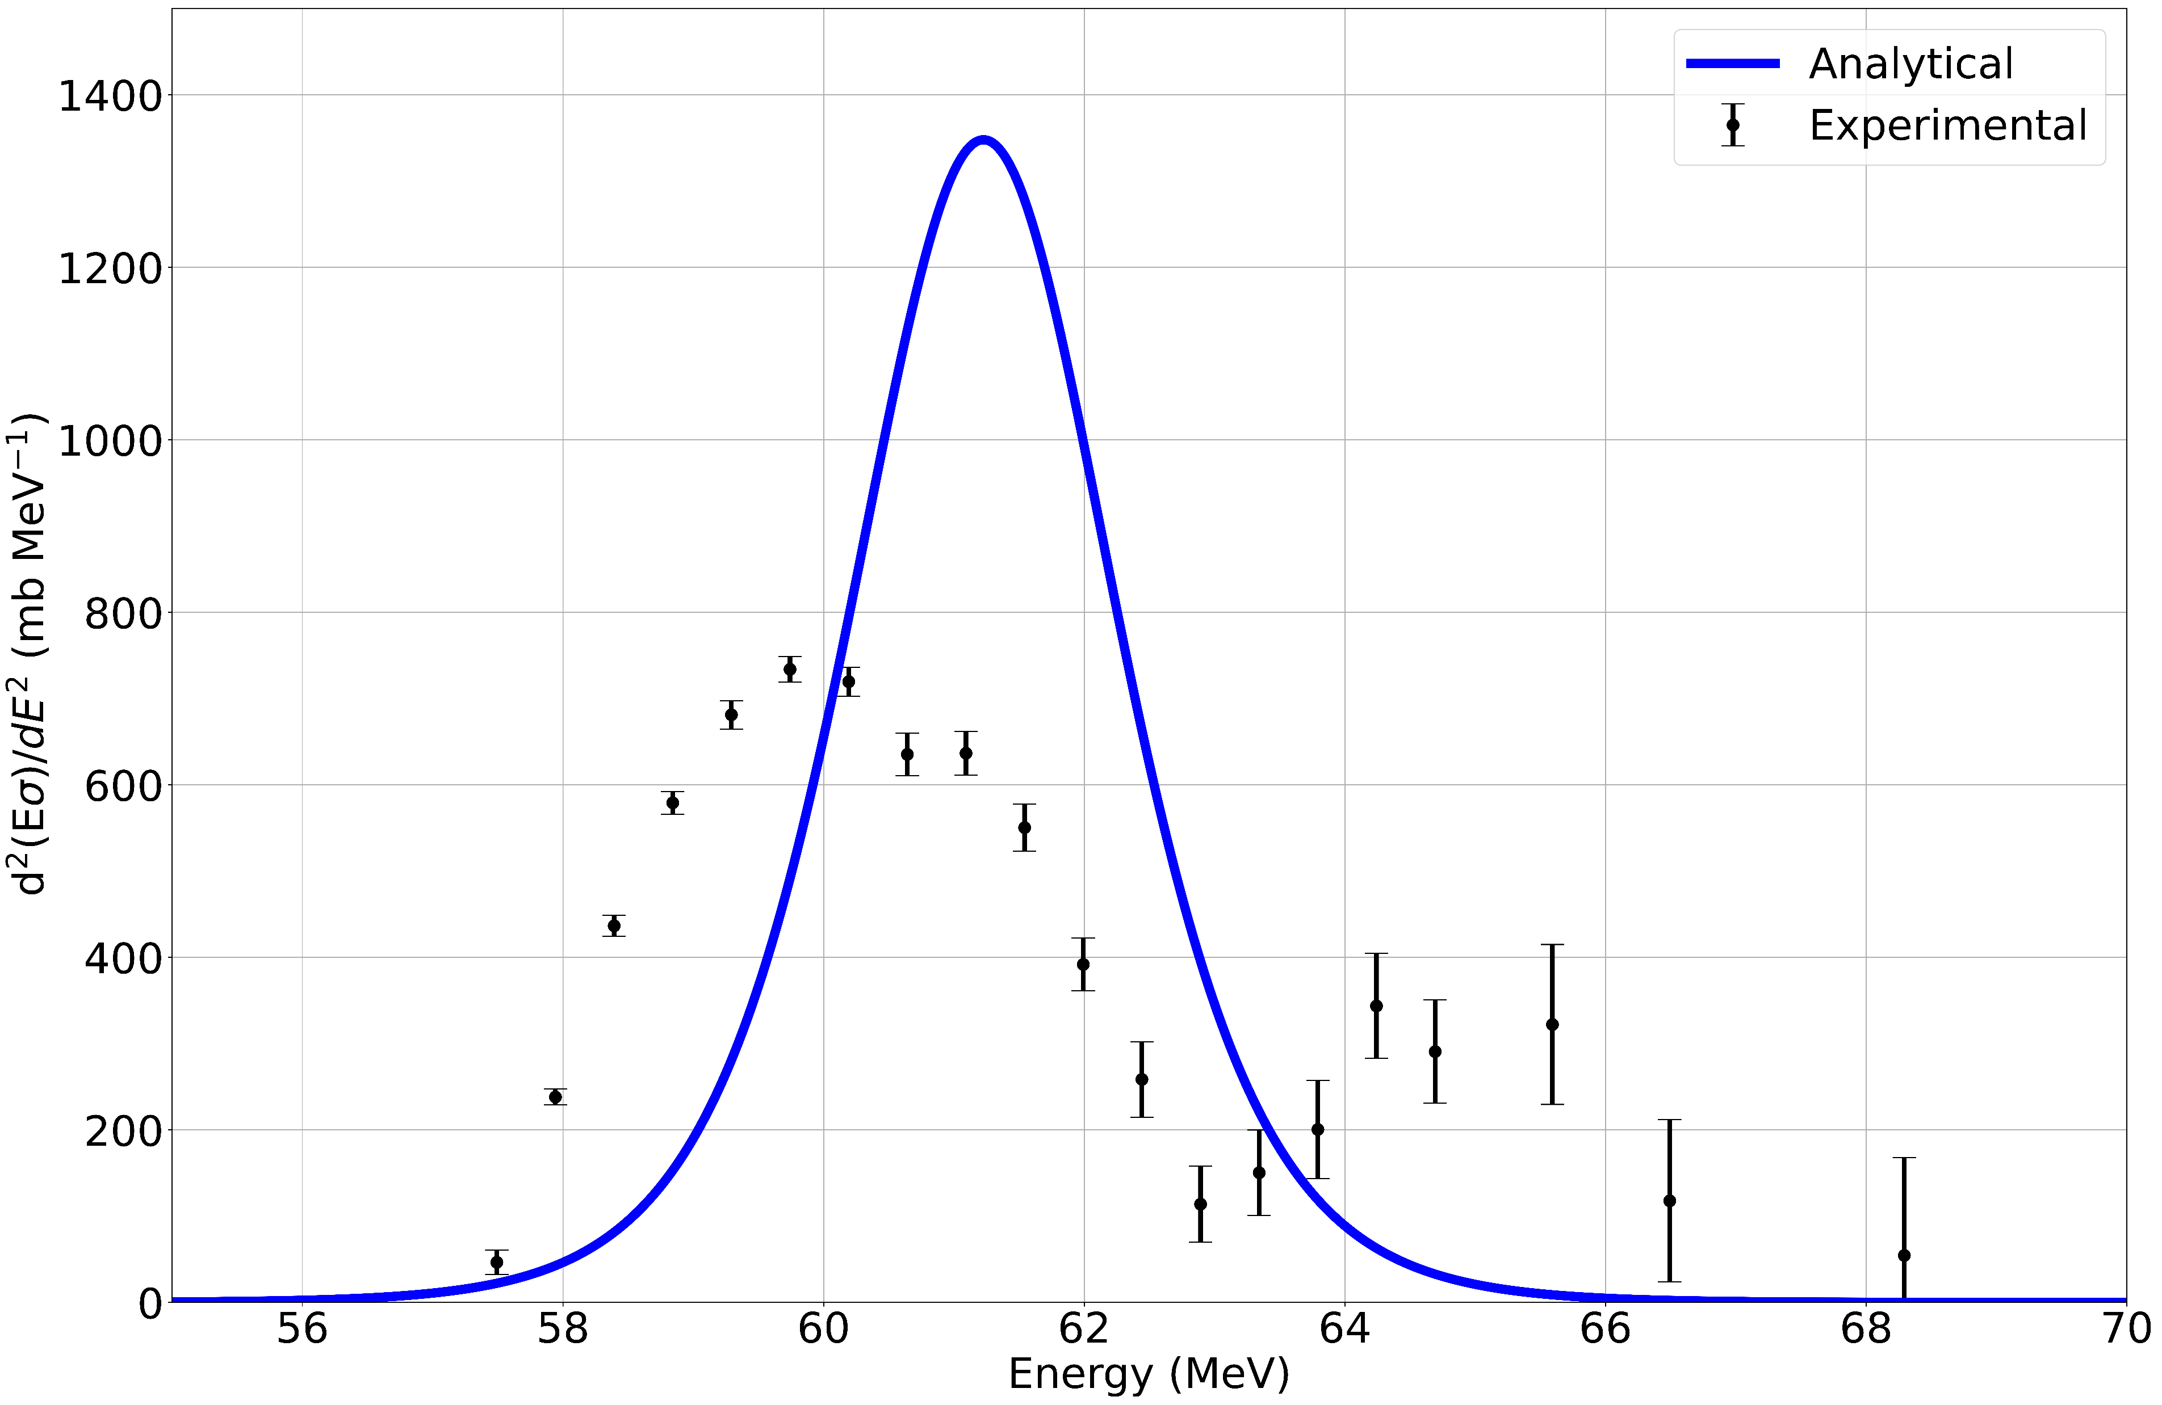
Barrier distribution

Slide 11
Gaussian Wave-packets
Advantages
Disadvantages
Existing wave equation solution
Symmetric
Abides by Heisenberg Uncertainty principle
Ground state solution
Localised and de-localised features
Simple + adjustable parameters
Boundary effects
Potential dependence
Dispersion
Distribution

Slide 12
Finite Difference Method
Advantages
Disadvantages
Derived from first principles
Simple implementation
If dt/(dx^2) small enough, numerical stability should hold
Has been proven as numerically unstable
Crank-Nicholson implicit method alternative
Poor stability over long time many steps
Long simulation times
Instead transform into Pade Matricies and use matrix multiplication
Takes up a lot of storage

Slide 13
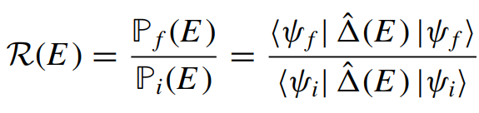
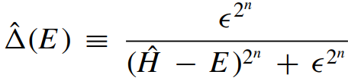

Window Operator
Wave-packets have a distribution of energies
Distribution inversely proportional to spatial width, σ₀
Experimental fusion reactions have sharp energy distributions
A window operator can be used to analytically resolved the energy distribution of the wave-packet
Allows for an improved transmission probability calculation

Slide 14
Model & sim Problems
Single Barrier Model is not a satisfactory model:
Sub-barrier intermediate mass fusion cross section experiments disagreed with model predictions
Inversion of experimental data allows for the extraction of a single barrier again disagreeing with model predictions
Barrier distribution does not agree, second peak in experimental data
Coupled channel model is the current formalism for fusion reactions
Gaussian wave-packet is a very ideal trial wavefunction but not perfect
Finite difference disadvantages
1hr simulation run time on home PC (1hr x 80sims)
Is not a self-contained simulation, requires parameter fitting e.g., Woods-Saxon variables

Slide 15
Coupled Channel Formalism
Coupling between other reaction channels occurs which enhances the fusion cross section at varying energies yielding a distribution of barriers
Channels: elastic, inelastic, transfer, break-up and fusion reactions
Coupling between the translational motion of the reactants and non-collective excitations in the compound nucleus, plus:
Static deformations
Vibrational modes
Transfer processes
Neck formations

Slide 16
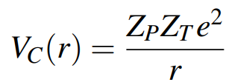
Coulomb equation

Slide 17
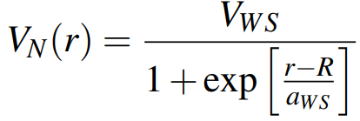
Woods-Saxon Equation

Slide 18
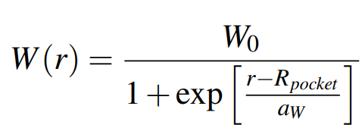
Imaginary potential

